Slide 1

MAJOR PROJECT
PERSONALIZED AI CHAT BOT
Submitted by:
Shruti Verma
Devershi Vashistha
Shrey Somwanshi
Guided by:
Mr. Titu Singh Arora

Slide 2
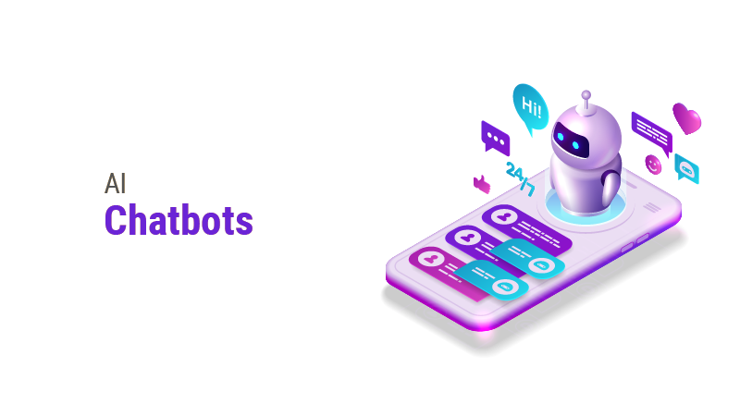
INTRODUCTION
AI (Artificial Intelligence) is the creation of intelligent machines that can perform tasks that typically require human intelligence.
AI chatbots are computer programs that use AI algorithms to simulate human-like conversations with users. They can be trained to understand natural language and respond to customer inquiries, provide support, and even make recommendations.
AI chatbots have the potential to revolutionize the way businesses interact with their customers, improving efficiency, reducing costs, and enhancing the overall customer experience

Slide 3
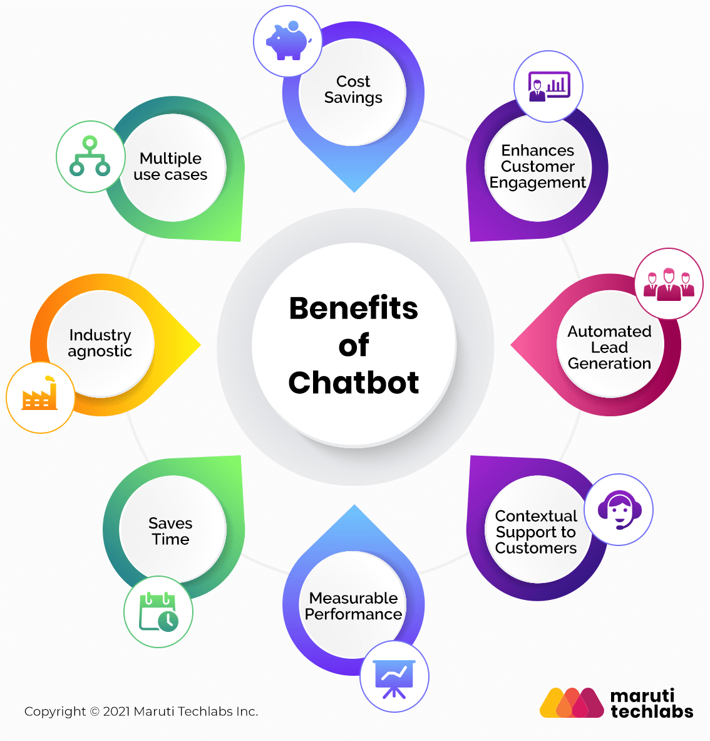

Slide 4





COMPONENTS

Slide 5
Key selling points

Slide 6


RASA
Rasa Open Source is an open source conversational AI platform that allows you to understand and hold conversations, and connect to messaging channels and third party systems through a set of APIs.

Slide 7
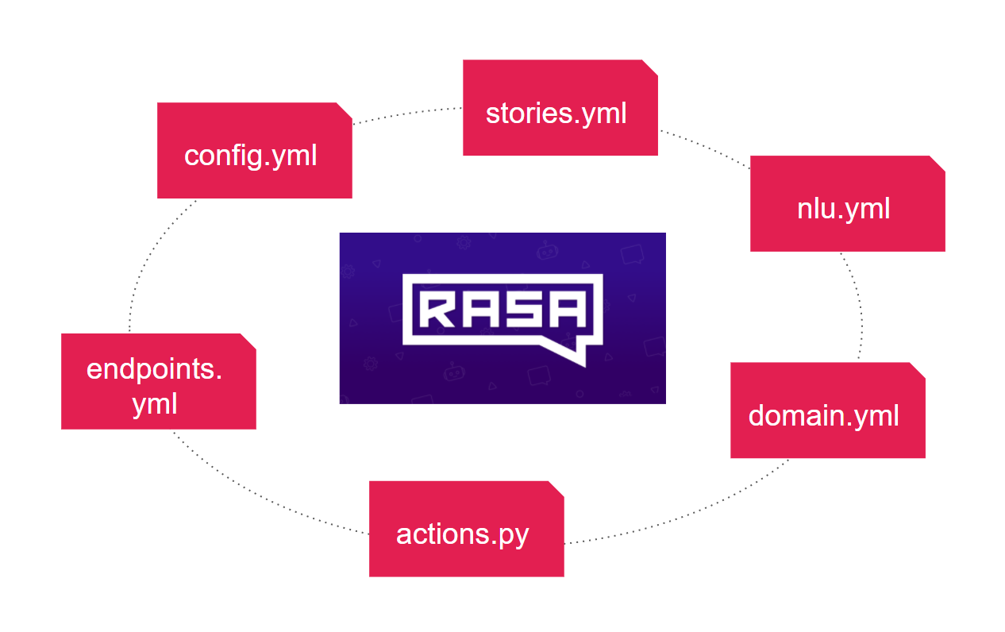
RASA STRUCTURE

Slide 8
RASA AI
Pipelines
Policies
WhitespaceTokenizer
RegexFeaturizer
LexicalSyntacticFeaturizer
CountVectorsFeaturizer
DIETClassifier
FallbackClassifier
TEDPolicy
Memoization Policy
UnexpecTEDIntentPolicy
RulePolicy

Slide 9

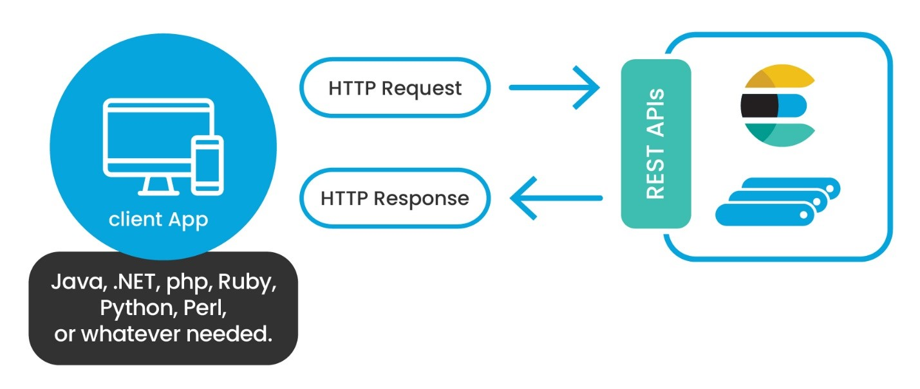
ELASTICSEARCH
Elasticsearch is an open-source search and analytics engine that is built on top of Apache Lucene.
It allows users to store, search, and analyze large volumes of data in real-time. Elasticsearch is scalable, fault-tolerant, and accessible through APIs and web interfaces.

Slide 10
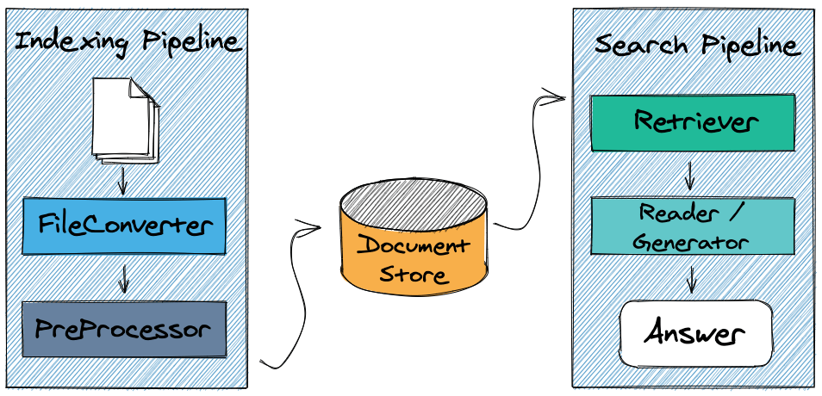
HAYSTACK
Haystack is an open-source framework for building search systems that work intelligently over large document collections.

Slide 11
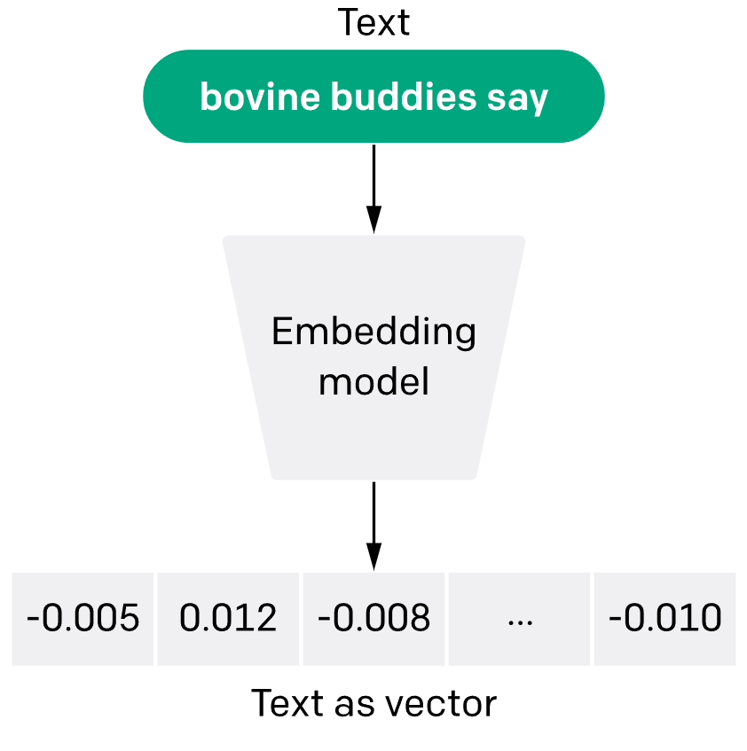
HAYSTACK AI
Hugging face Transformers
sentence-transformers/all-MiniLM-L6-v2

Slide 12
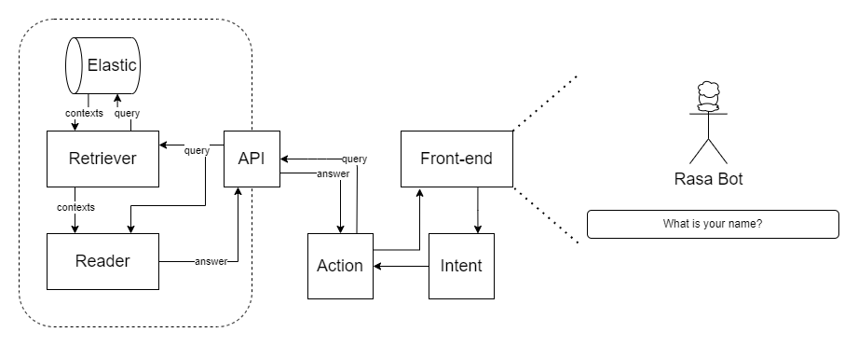
RASA and HAYSTACK

Slide 13
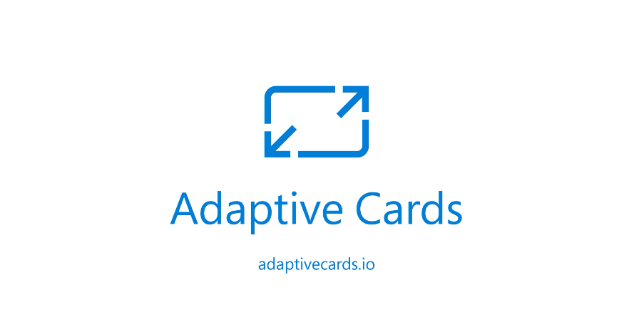
STREAMLIT
Streamlit is an open-source Python library used for building and deploying data-driven web applications. Streamlit provides a simple and intuitive API for creating custom user interfaces, supporting various input widgets such as sliders, dropdowns, and checkboxes.

Slide 14
Docker

Slide 15
Use case

